Slide 1
File Encryption and Decryption Tool
Java Mini-Project

Slide 2
TechTetra (group members)
Roll No | Student Name
26 | Kshitija Anil Jiwaje
32 | Shravani Mahesh Mali
46 | Rasika Bapuso Bendugale
50 | Sandhya Sardar Chougale

Slide 3
Introduction
File encryption is one of the most effective methods to secure data. This project provides a Java-based desktop tool for encrypting and decrypting files using AES. In the digital era, data security has become a paramount concern for individuals and organizations alike. With the increasing reliance on digital storage and transmission of sensitive information, protecting data from unauthorized access has become a critical necessity. File encryption is a powerful technique used to ensure the confidentiality and integrity of digital data.

Slide 4

Objective
To implement AES symmetric key cryptography in Java.
To provide a GUI-based system for better usability.
Ensure that the tool supports all file types.
To design an intuitive and user-friendly interface that simplifies the encryption and decryption process.

Slide 5
Working of the model
Step 1
User selects the input
Step 2
On clicking “Encrypt,” AES key is generated and saved.
Step 3
File is encrypted and saved at the chosen location.
Step 4
Step 5
Encrypted file is decrypted and restored.t file and destination paths.
On clicking “Decrypt,” saved key is loaded.

Slide 6
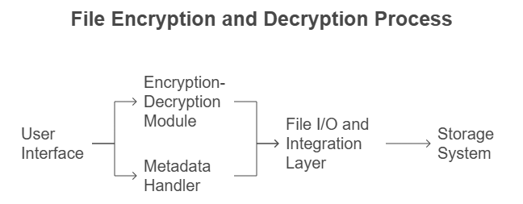
System architecture
User Interface (UI): Java Swing-based file selection & action buttons
Encryption/Decryption Module: AES encryption/decryption with key generation
Metadata Handler: Saves and reads file descriptions (.meta files)
File I/O & Integration: Handles file operations and module coordination
Storage System: Saves and reads file descriptions (.meta files)

Slide 7
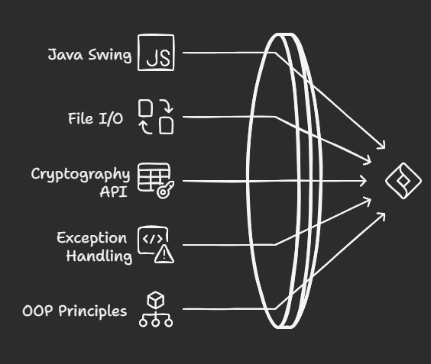
Java Swing: For GUI design and user interaction
File I/O (java.io, java.nio): For reading/writing files and keys
Java Cryptography API (javax.crypto): For AES encryption and decryption
Exception Handling: To manage file and encryption errors
OOP Principles: Class-based modular design (GUI, Encryption, Decryption modules)

Slide 8
Conclusion
Secure File provides an efficient and user-friendly way to protect files. AES-based encryption ensures strong security. GUI enhances usability for non-technical users. Can be extended to include password-based encryption or logging. By harnessing the power of symmetric encryption algorithms, such as the Advanced Encryption Standard (AES), this tool provides a robust and efficient means of protecting files from unauthorized access.

Slide 9
Thank You!
- By TechTetra (Group-4) SY CSE A

